Slide 1
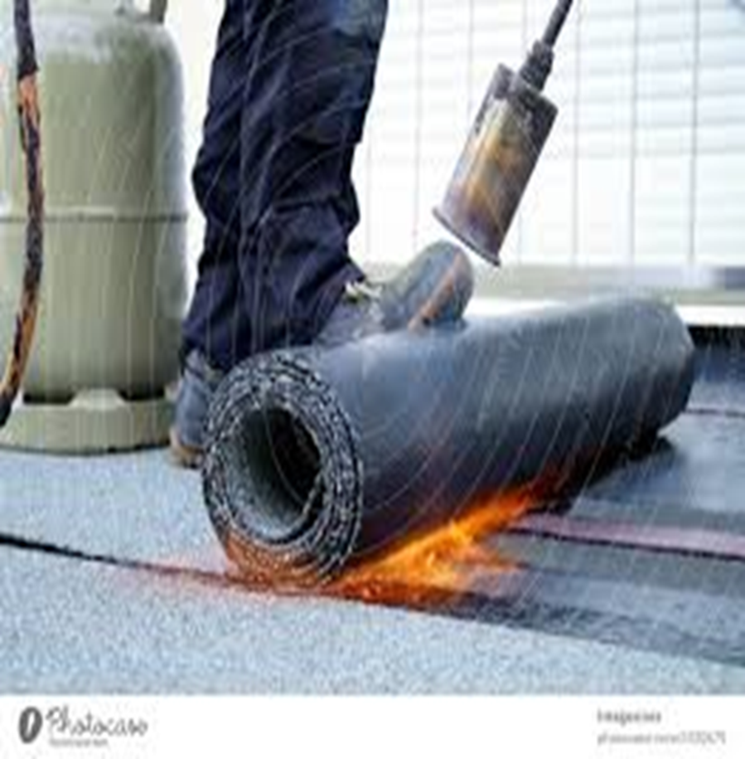
Waterproofing Maintenance
Video : Introduction to Waterproofing
https://youtu.be/hByGbg6wI8I?si=P_CxZYwz81B_B7VT

Slide 2
Waterproofing Maintenance
Safety rules in the workshop.
1. Conduct risk management prior to commencing the waterproofing works.
2. Provide personal protective equipment(PPE).
3. Ensure that all workers involved in waterproofing work are trained and qualified.
4. Ensure that all electrical tools and equipments used are regularly maintained and inspected for defects.
5. Establish a safe work area.
6. Establish emergency procedures and equipments.
7. Establish a safe work area and use of signage to warn others.
8. Ensure that the worksite is properly ventilated.
9. After completion of work, ensure that all equipments are properly cleaned.
10. Conduct a post work inspection.
Video :
https://youtu.be/GNSx0PJEmA0?si=Ysp_8JAu0_eMDRzL
Feedback : Activity

Slide 3
Kwa Thema Skills School
Subject : Maintenance Marks : 10
Grade : Year 1 Time : 30 mins
Date : / / 2024
Question:1
1. Use the words provided in brackets to complete the following sentences.
1.1. After completion of work, ensure that all equipments are properly ___________.
1.2 Provide personal ________________equipment(PPE).
1.3. Ensure that all workers involved in waterproofing work are trained and _____________.
1.4. Conduct a post work _________________.
1.5. Establish a ___________ work area.
1.6. Establish emergency procedures and ________________.
1.7. Establish a safe work area and use of signage to warn others.
1.8. Ensure that the worksite is properly _______________.
1.9. Ensure that all _______________ tools and equipment used are regularly maintained and inspected for defects.
1.10. _______________ risk management prior to commencing the waterproofing works.
(qualified: signage: ventilation: inspection: cleaned: equipments: safe: electrical: protective: conduct)
(10)

